Slide 1
Data Structure and Algorithm CSE- 225
Dr. Mohammad Abu Yousuf
yousuf@juniv.edu

Slide 2
Tree : A Non linear Data Structure

Slide 3
Introduction
Store elements hierarchically
The top element: root
Except the root, each element has a parent
Each element has 0 or more children

Slide 4
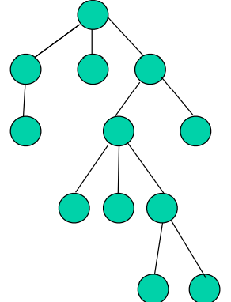
Introduction

Slide 5
Introduction
Tree represents nodes connected by edges.
A binary tree (T) has a special condition that each node can have two children at maximum.
If T is empty called null tree or empty tree
T contains a distinguished node R, called the root of T.
If T contains a root R, then two trees T1 and T2 are called the left and right sub-tree respectively.
If T1 and T2 is nonempty the its root is called left and right successor.

Slide 6
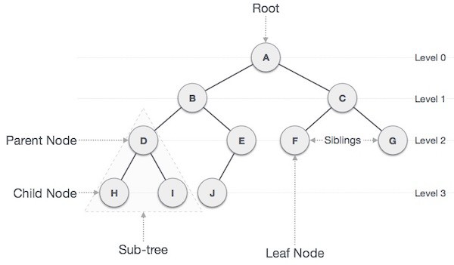
Binary Tree

Slide 7
Binary Tree
Root − Node at the top of the tree is called root.
There is only one root per tree and one path from root node to any node.
Parent − Any node except root node has one edge upward to a node called parent.
Child − Node below a given node connected by its edge downward is called its child node.
Leaf − Node which does not have any child node is called leaf node.
Levels − Level of a node represents the generation of a node. If root node is at level 0, then its next child node is at level 1, its grandchild is at level 2 and so on.

Slide 8
Binary Tree
Complete binary tree
All its level, except the last have the maximum number of possible nodes.
Extended binary tree
If each node has either 0 or 2 children.

Slide 9
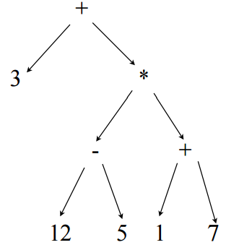
Tree associated with an arithmetical expression
Consider the expression: 3 + (12-5)*(1+7)

Slide 10
Tree associated with an arithmetical expression
Construct a binary tree for the following algebraic expression:
E = (a-b)/((c*d)+e)

Slide 11
Binary Tree Traversal
Traversal is a process to visit all the nodes of a tree.
There are three ways to traverse a tree:
In-order Traversal
Pre-order Traversal
Post-order Traversal

Slide 12
Binary Tree Traversal: In-order
In this traversal method, the left sub-tree is visited first, then root and then the right sub-tree.
Every node may represent a sub-tree itself.
If a binary tree is traversed in-order, the output will produce sorted key values in ascending order.

Slide 13
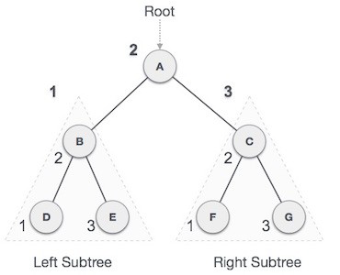
Binary Tree Traversal: In-order
Until all nodes are traversed:
Step 1: Traverse left sub-tree.
Step 2: Process the root node.
Step 3: Traverse right sub-tree.
For this tree, the output will be:
D → B → E → A → F → C → G

Slide 14
Binary Tree Traversal: Pre-order
Until all nodes are traversed:
Step 1: Process the root node.
Step 2: Traverse the left sub-tree.
Step 3: Traverse the right sub-tree.
For this tree, the output will be:
A → B → D → E → C → F → G

Slide 15
Binary Tree Traversal: Post-order
Until all nodes are traversed:
Step 1: Traverse the left sub-tree.
Step 2: Traverse the right sub-tree.
Step 3: Process the root node.
For this tree, the output will be:
D → E → B → F → G → C → A

Slide 16
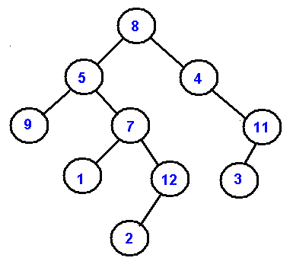
Tree Traversal: Exercise

Slide 17
Tree Traversal: Solution
✔ Pre-Order - 8, 5, 9, 7, 1, 12, 2, 4, 11, 3
✔ In-Order - 9, 5, 1, 7, 2, 12, 8, 4, 3, 11
✔ Post-Order - 9, 1, 2, 12, 7, 5, 3, 11, 4, 8

Slide 18
Binary Search Tree

Slide 19
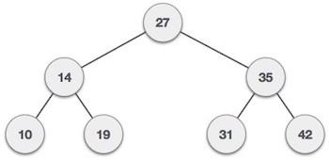
Introduction
A binary search tree (BST) follows:
The left sub-tree of a node has key less than or equal to its parent node's key.
The right sub-tree of a node has key greater than or equal to its parent node's key.

Slide 20
Introduction
The keys in a binary search tree are always stored in such a way as to satisfy the binary-search-tree property:
“Let x be a node in a binary search tree. If y is a node in the left sub-tree of x, then y.key ≤ x.key. If y is a node in the right sub-tree of x, then y.key ≥ x.key”.
Thus, in Figure (a), the key of the root is 6, the keys 2, 5, and 5 in its left subtree are no larger than 6, and the keys 7 and 8 in its right subtree are no smaller than 6. The same property holds for every node in the tree.

Slide 21
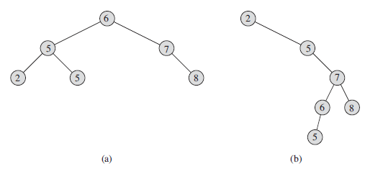
Introduction
Binary search trees. For any node x, the keys in the left sub-tree of x are at most x.key, and the keys in the right sub-tree of x are at least x.key.
Different binary search trees can represent the same set of values. The worst-case running time for most search-tree operations is proportional to the height of the tree. (a) A binary search tree on 6 nodes with height 2. (b) A less efficient binary search tree with height 4 that contains the same keys.

Slide 22
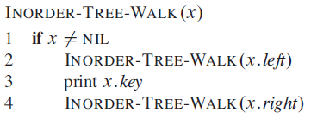
Introduction
The binary-search-tree property allows us to print out all the keys in a binary search tree in sorted order by a simple recursive algorithm, called an in order tree walk.
Each node contains attributes left, right, and p that point to the nodes corresponding to its left child, its right child, and its parent, respectively.

Slide 23
Introduction
As an example, the in order tree walk prints the keys in each of the two binary search trees from Figure in the order 2, 5, 5, 6, 7, 8.
It takes ‚ Θ(n) time to walk an n-node binary search tree, since after the initial call, the procedure calls itself recursively exactly twice for each node in the tree—once for its left child and once for its right child.

